Slide 1
Competitive Programming
03 Mar. 2023
Andrei Novikov

Slide 2
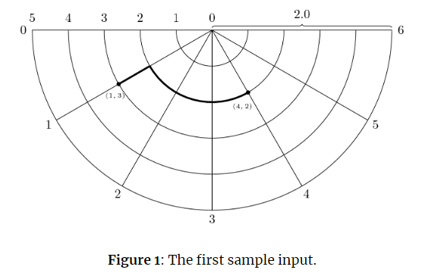



Home task Review
Beautiful task that requires some math knowledge: Link on Kattis.
1. Find formula that calculate distance between two points using minimum Y between them:
$$dx=\frac{πr}{M}\left|x_{1}−x_{2}\right|$$
$$r=\frac{R}{N}\min\left(y_{1},y_{2}\right)$$
$$dy=\left|y_{1}−y_{2}\right|\frac{R}{N}$$
$$distance=dx+dy$$
2. Using the same formula, compare if it is faster to go via 0.
Complexity: O(1)
Brute Force: Dijkstra algorithm O(V^2)

Slide 3


Home task Review
Beautiful task that requires some math knowledge: Link on Kattis.
Solution: Link to Source Code

Slide 4
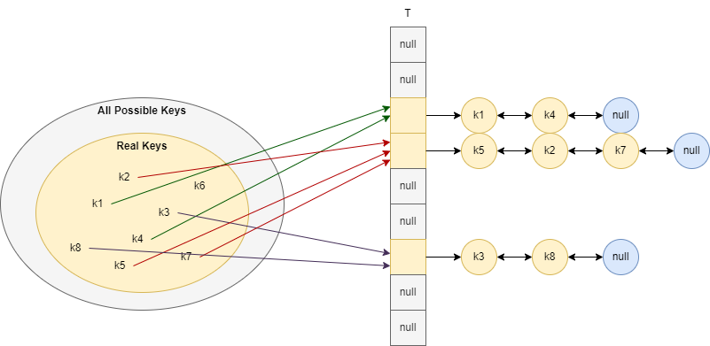
Revise Hash Tables – Chaining
The average complexity depends on the implementation of hash function.

Slide 5
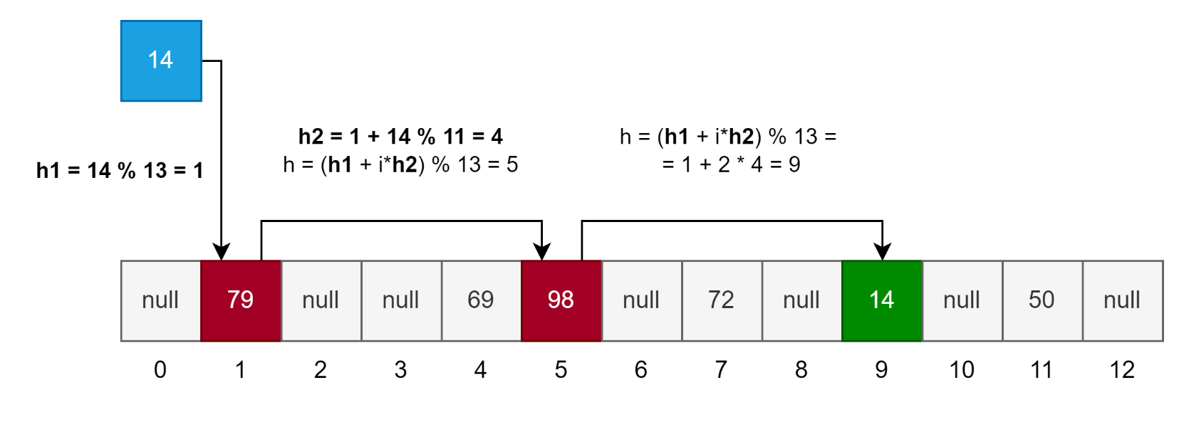
Revise Hash Tables – Open Addressing
In case of open addressing, all elements are stored in array directly.
But instead search in [0, m), we can search in <h(k, 0), h(k, 1), …, h(k, m - 1)>
Double hash to resolve collisions in open addressing hash table:
h(k, i) = h(h₁(k) + ih₂(k)) mod m
h1(k) = k mod 13
h2(k) = 1 + k mod 11

Slide 6
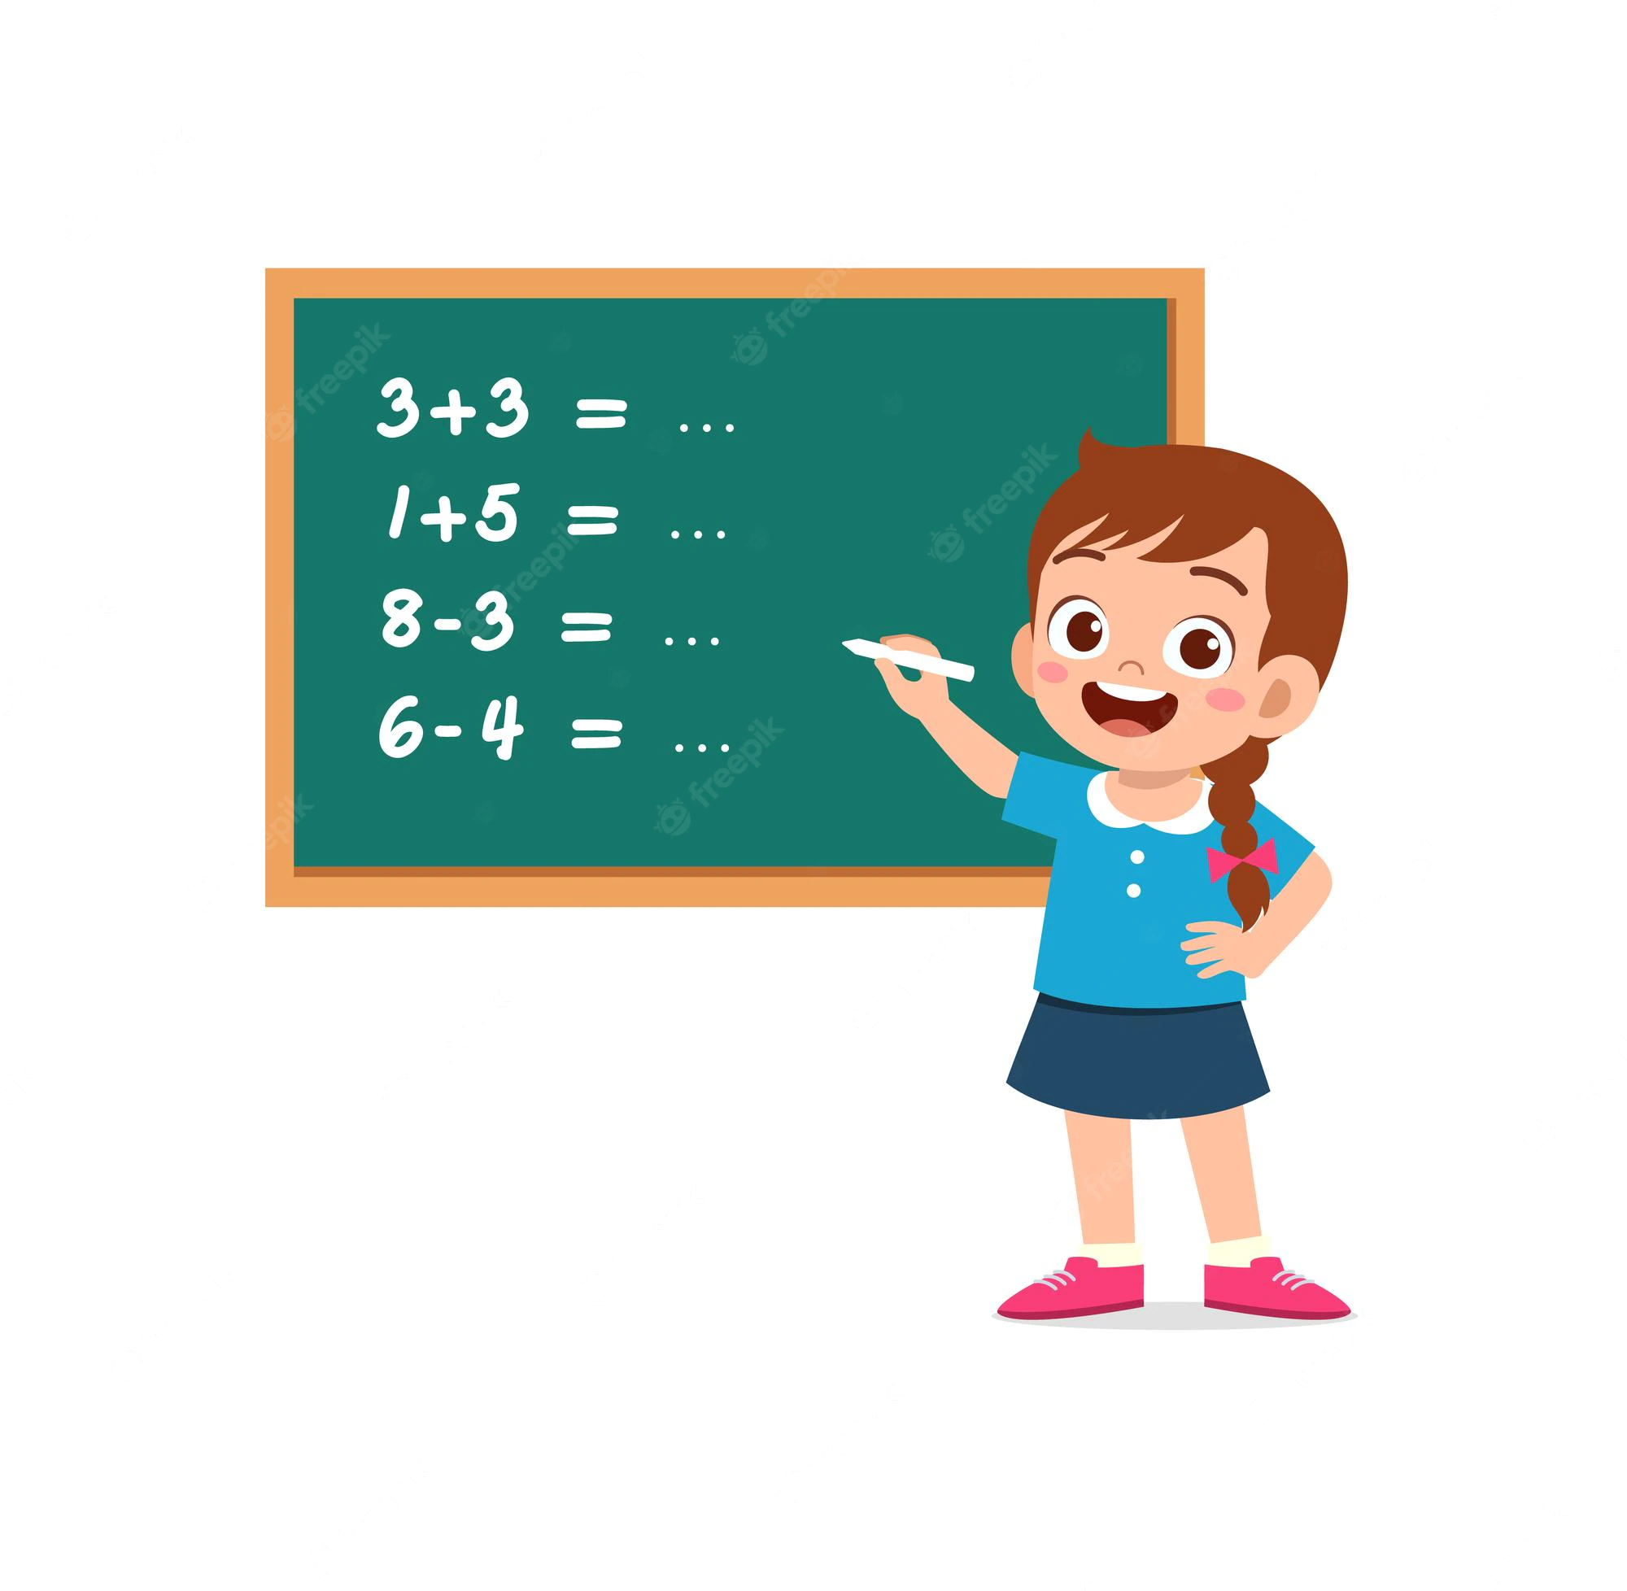
Practice – Implement Hash Table
Let's implement own hash table.

Slide 7
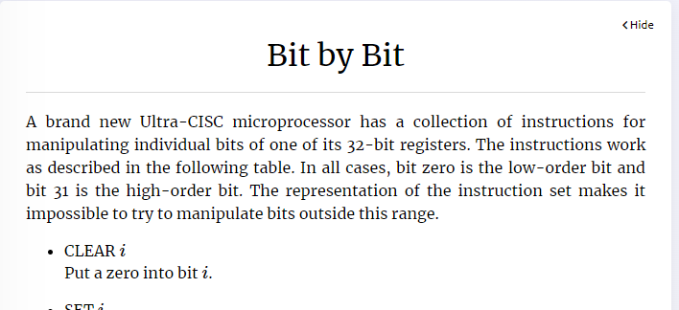
Homework?
Bit by Bit – Link on Kattis

Slide 8




Where to Practice
LeetCode [link]
HackerRank [link]
Kattis [link]
TopCoder [link]
Other Resources

